Slide 1
BIG question: can we use psychological therapies to reduce offending?

Slide 2
Anger and offending
“an arousal state of antagonism toward someone or something perceived to be the source of an aversive event” (Novaco, 2000)
Impulsive violence
Anger
Premeditated violence
Nonviolent offending?

Slide 3
Anger and violent offending (Novaco, 2011)
Stimulus
Justificatory schemas
Cognitive appraisal
Anger
Reduced inhibitions
VIOLENCE
Disrupted reappraisal

Slide 4
Anger management training
Anger management is a cognitive behavioural treatment.
What assumptions are made about the underlying problem and solution?
What sorts of techniques are likely to be involved?

Slide 5
Anger management training
Brief (20-40 hours) intervention
Aims:
Understand nature of anger and link with violence.
Recognise the signs of anger and diffuse them.
Notice and substitute cognitions that cause and sustain anger.
Teach coping strategies for anger.
Teach appropriate alternatives to aggression.
Group based, with (1) cognitive preparation; (2) skills acquisition; (3) application practice.

Slide 6
What is a ‘meta-analysis’?

Slide 7
Effectiveness of anger management
Meta analysis by Henwood et al (2015):
Searched literature, 3000+ potentially relevant studies.
Identified subset of 61 articles.
48 excluded (inadequate methodology).
14 studies considered:
CBT-based AMT
RCT or NRCT with suitable control group
50%+ adult male offender samples
Reconviction as outcome measure

Slide 8
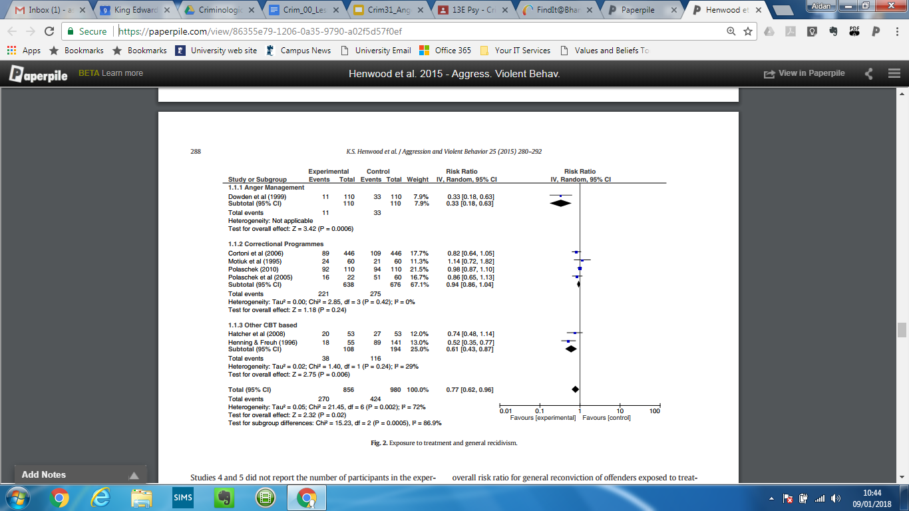
Effectiveness of anger management

Slide 9
Effectiveness of anger management
Overall:
23% reduction in general recidivism with AMT.
28% reduction in violent recidivism with AMT.

Slide 10
Problem with the research
Selection bias - less risky clients channeled towards treatment?
Performance bias - treatment not delivered as designed?
Measurement bias - reconviction data poor?
Attrition bias - dropouts more likely to reoffend?
Reporting bias - unfavourable data left out?

