Slide 1
BIG question: how do recreational drugs affect what people think, feel and do?

Slide 2
Drugs, the brain and behaviour

Slide 3
Recreational drugs
A drug is a chemical that alters the functioning of the body.
A psychoactive drug is one that causes changes to thinking, feeling and/or behaviour because it alters the functioning of the brain.
A recreational drug is one that is taken without justification for its medical effects. This depends in the context of use, not the actual chemical properties of the drug. Morphine is a powerful painkiller in a medical context but is also used recreationally for the feeling of euphoria it produces. LSD is primarily known for the vivid hallucinations it induces but also has medical uses in the treatment of depression and alcoholism.

Slide 4
Recreational drugs
The majority of psychoactive drugs have their effects because of the way they alter what happens during synaptic transmission.

Slide 5
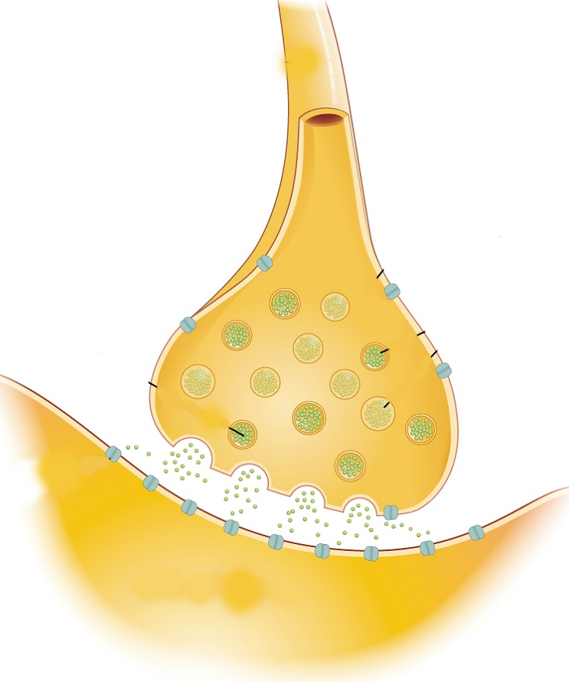
Recreational drugs
Increase release of neurotransmitter
Block reuptake mechanism
Block action of enzymes
Stimulate post-synaptic receptors
Block post-synaptic receptors
Changes to firing rate of the post-synaptic neuron.

Slide 6
Research task
Use the linked resource to find out about the mode of action and effects of some of the recreational drugs you have heard of. Make notes of what you learn.
https://ocw.mit.edu/ans7870/SP/SP.236/S09/lecturenotes/drugchart.htm

Slide 7
Outside class...
Make a poster outlining the effects of one recreational drug. Include an explanations of its effect on synapses/brain areas and whether it causes tolerance & dependency.
Details on Google Classroom.

Slide 8
Comparisons
Comparing things helps to deepen our understanding. Select two drugs your group has been learning about and generate some comparisons using our comparison VTR.
Generate facts
Look for correspondences
Fill in the gaps

Slide 9
Reflection
What have you learned?
What has it made you think/feel?
What are you going to do?

