Slide 1
The BIG question: how does a bunch of cells give rise to thinking?

Slide 2
Synaptic transmission

Slide 3
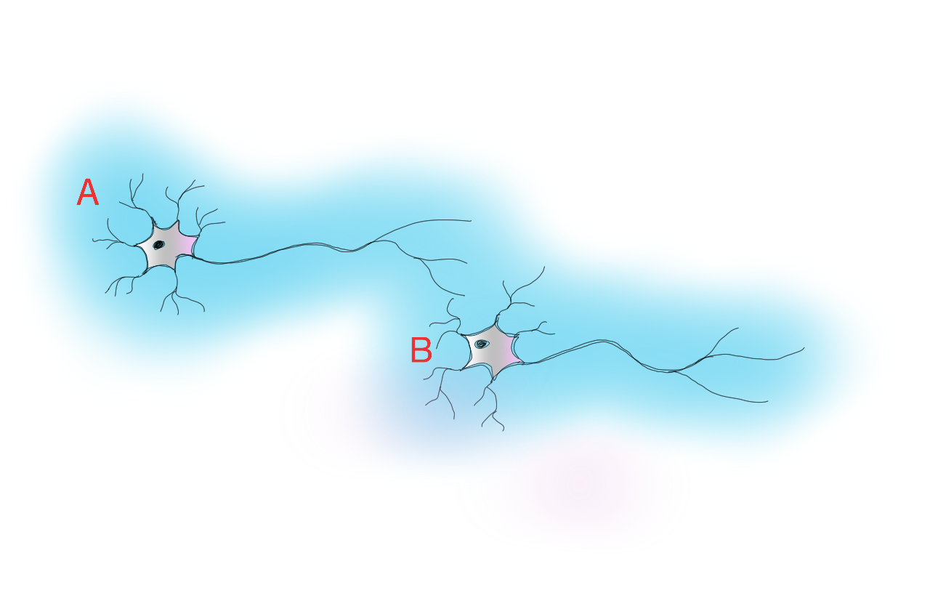
Synaptic transmission
Notes:
Neurons produce APs at varying frequencies. The firing rate of one neuron influences the firing rates of this that receive connections from it.

Slide 4
Socrative Quiz (2.0 content)

Slide 5
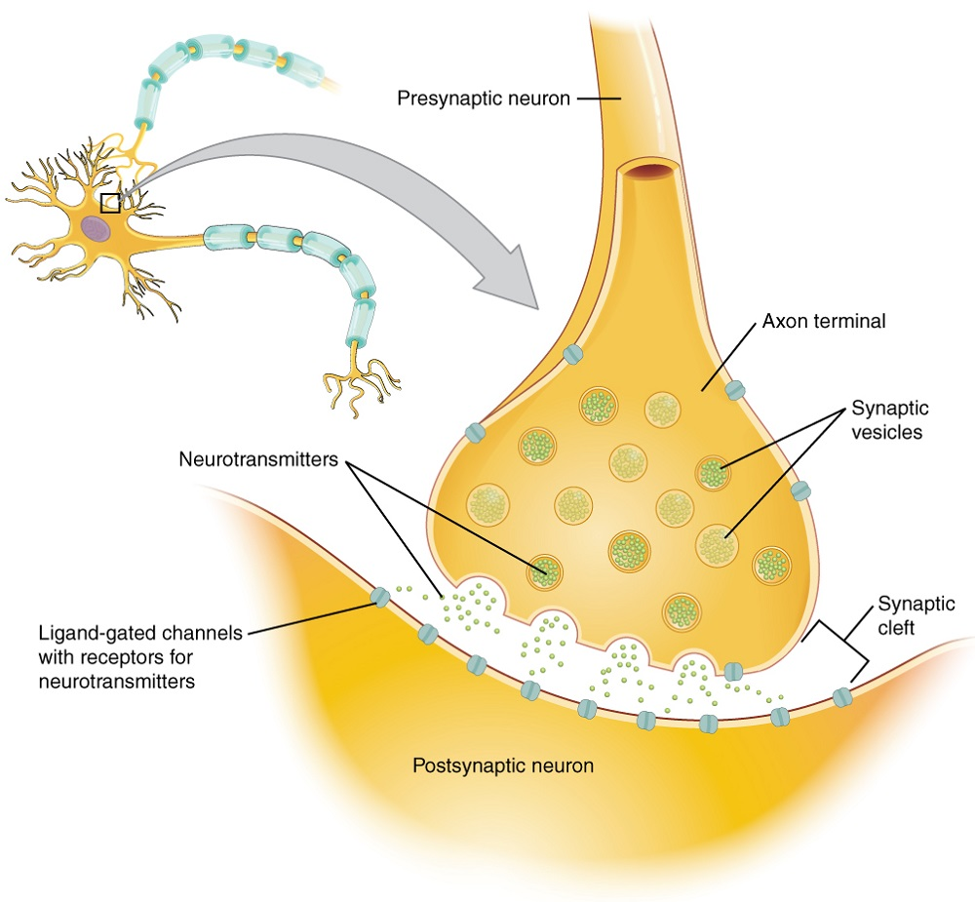
Synapses

Slide 6
Modelling synaptic transmission
We are going to create a model of synaptic transmission. Each of you will be playing different parts but each of you will need to understand the whole process.

Slide 7
Analogies
Analogies deepen our understanding things. A model is a sort of analogy.
Write an explanation of how our model of synaptic transmission represents the real process.

Slide 8
Class or home learning
An exercise to help you ‘join up’ what you have learned about neuronal and synaptic transmission.

Slide 9
Reflection
What has happened/what have you learned?
What has it made you think/feel?
What are you going to do?

