Slide 1
The BIG question: how does a bunch of cells give rise to thinking?

Slide 2
Neurons and neural transmission

Slide 3
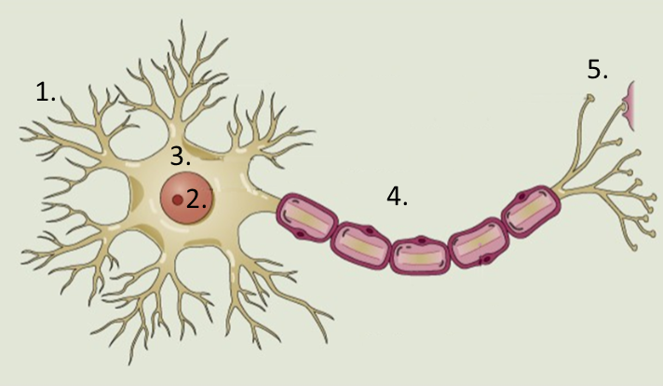
Label this neuron

Slide 4
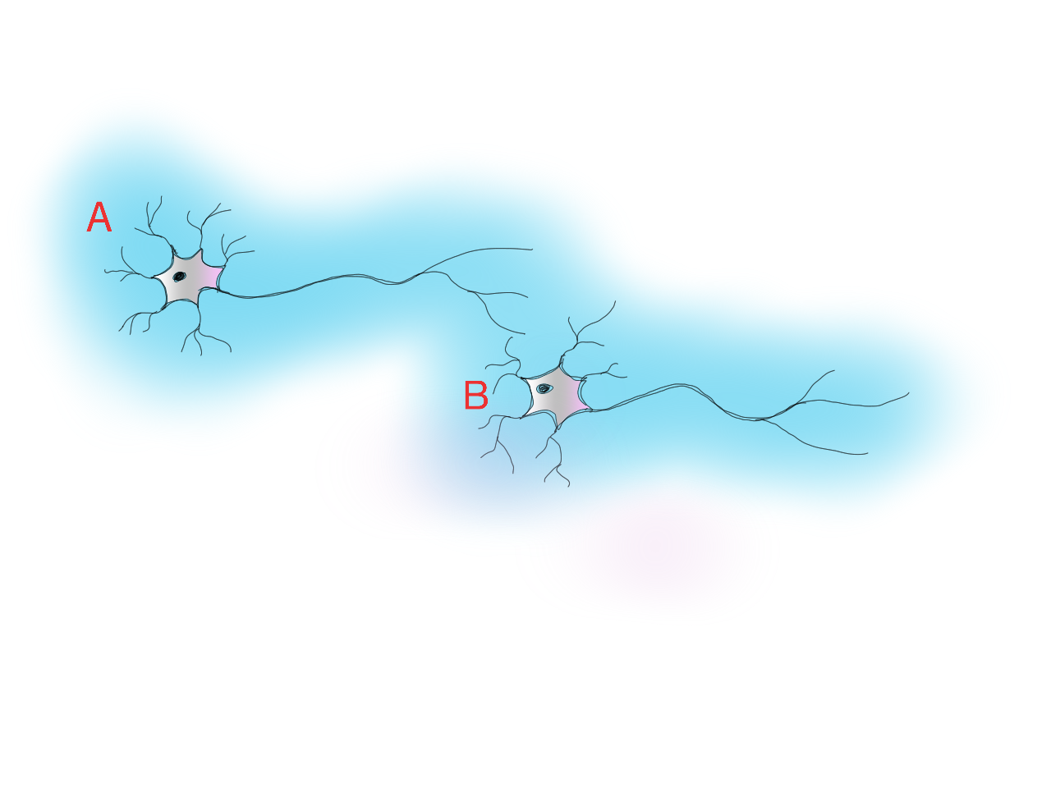
Neuronal transmission
Notes:
Neurons produce APs at varying frequencies. The firing rate of one neuron influences the firing rates of this that receive connections from it.

Slide 5
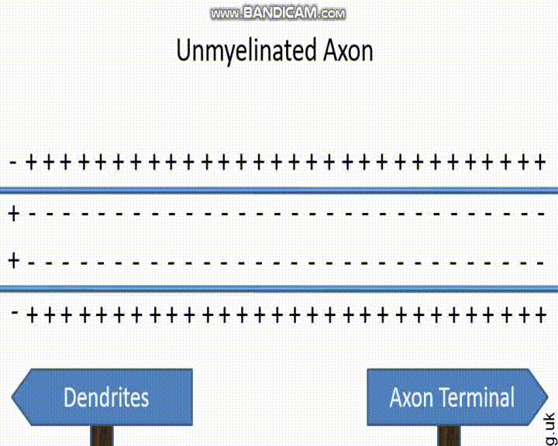

Slide 6
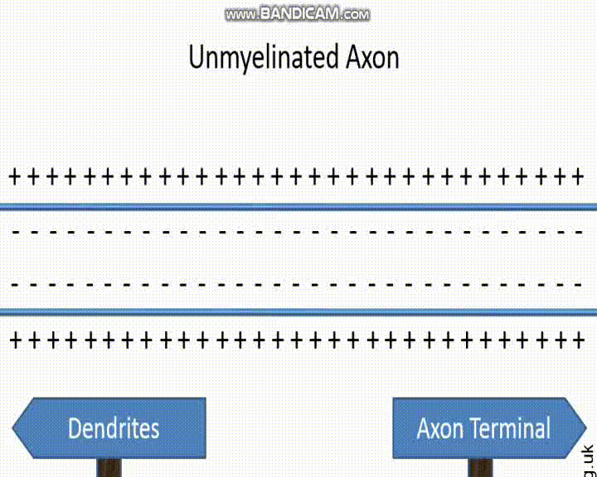

Slide 7
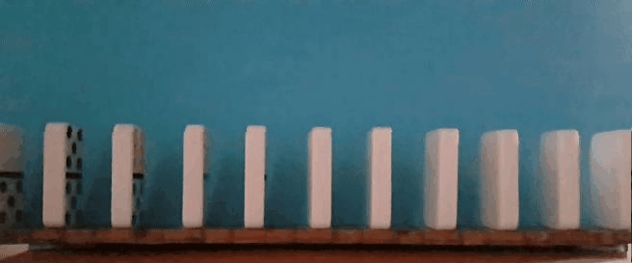

Slide 8
Sequencing
As a group:
One the cards are a set of steps that, together, describe the the action potential and the process of neural transmission.
Assemble the correct sequence of events.
Individually:
Write an account of the process. Challenge: from memory.

Slide 9
Socrative quiz

Slide 10
Analogies
An action potential is like a ‘Mexican wave’ because…
An action potential is like toppling dominos because...

Slide 11
Reflection
What has happened/what have you learned?
What does it make you think/feel?
What are you going to do?

