Slide 1
The BIG question: which part of the brain does what and how do we know?

Slide 2
Brain scanning
CAT, PET and fMRI

Slide 3
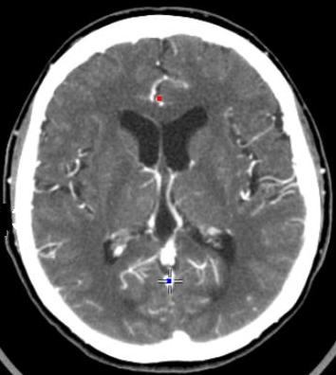
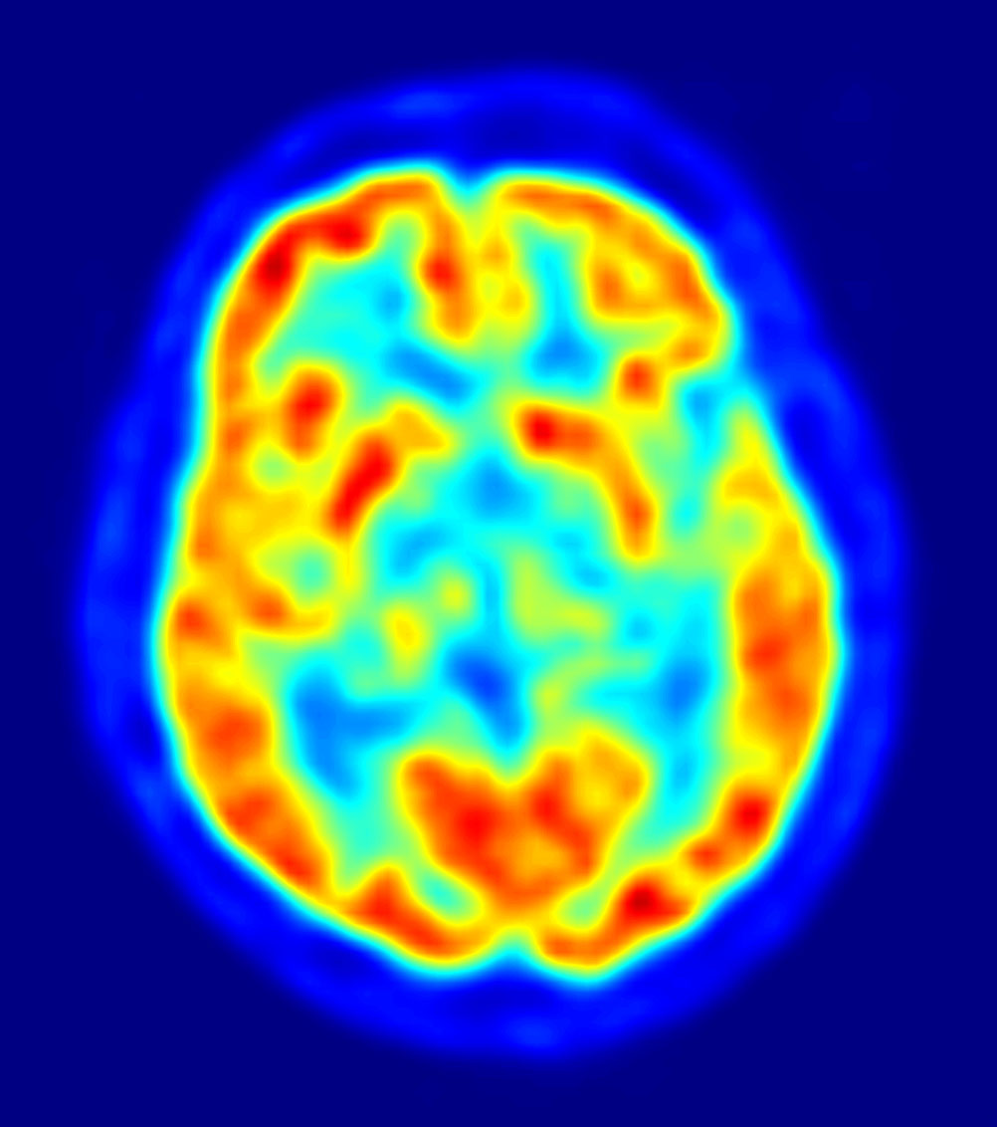
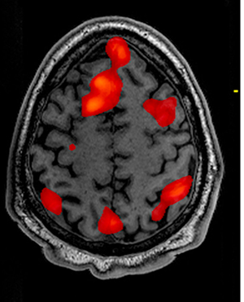
Investigating the brain with scans
CAT/CT Scan
PET Scan
fMRI Scan

Slide 4
Deep reading
Divide up the text
Choose a teacher
Silent reading
Teacher’s question
Discuss and agree
Teacher’s summary
Choose a new teacher

Slide 5
Comparing
Identifying and explaining the similarities and difference between things. Comparing deepens our understanding of the things we are learning.
Generate facts
Look for things that go together
Find and fill gaps

Slide 6
Comparing when we write
1. Identify what the similarity or difference relates to.
2. Give the facts about each to back yourself up.
E.g. one difference between
One difference between ___ and ___ is ___ because one is ___ whereas the other is ___.
One similarity between ___ and ___ is ___ because both ___.
___ is superior to ___ in relation to ___ because ___.

