Slide 1
Biological Psychology
1. The central nervous system

Slide 2
The BIG question: which part of the brain does what and how do we know?

Slide 3
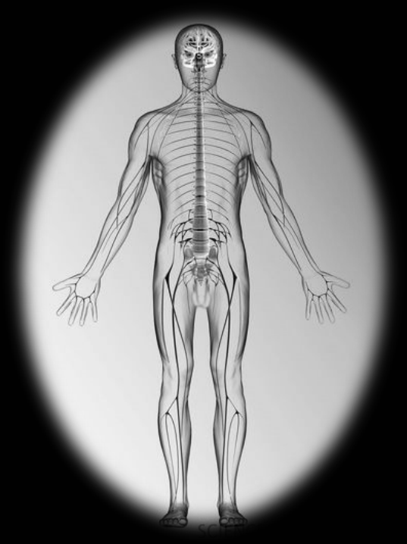
The nervous system
The nervous system is a network of specialised cells capable of transmitting information around the body. It co-ordinates the behaviour of the organism.
The central nervous system processes information. It consists of the brain and spinal cord.

Slide 4
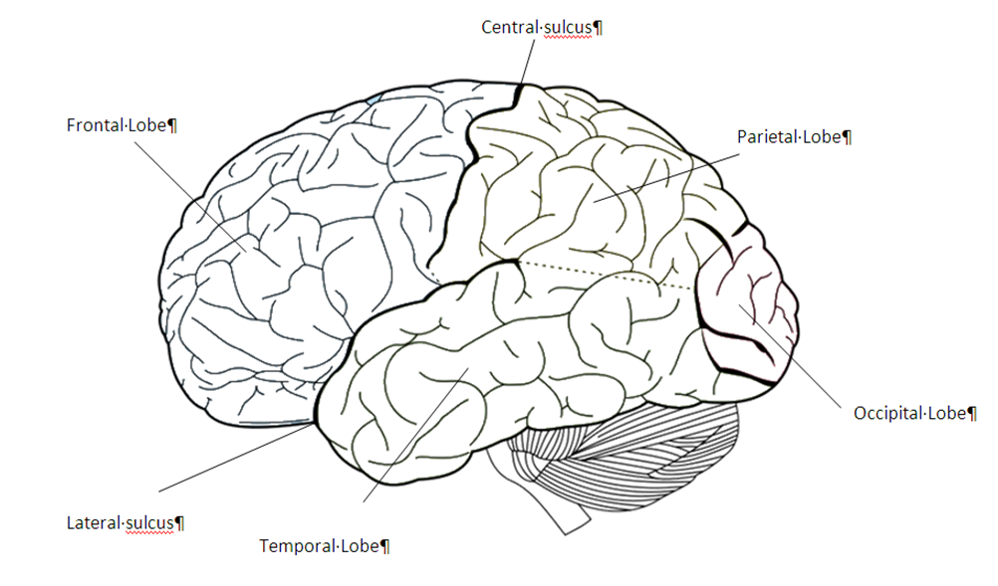
The Brain

Slide 5
Brain functions are localised and lateralised.
Visual processing is localised in the occipital lobe.
Language processing is lateralised on the left side of the brain (in most people)

Slide 6
Socrative quiz - structures of the brain

Slide 7
Follow-up questions

Slide 8
Analogies
When we make analogies, we compare things we know about with things we are learning about. This helps to deepen our understanding.
Choose one of the following to start (but try them all):
The brain is like an orchestra because…
The brain is like a city because…
The brain is like a computer because…
Extend the analogy as far as you can!

Slide 9
Recall quiz
Sketch a side view of the brain. Label as many areas as you can with their name and functions.
Top tip for learning: every time you recall a memory you strengthen it and make it more available next time you need it.

Slide 10
Reflection time
What has happened? What have you learned?
What does that make you think/feel?
What are you going to do?

