Slide 1
Cognitive Psychology
Cognitive psychology is the study of thinking processes. Cognitive psychologists use scientific methods to investigate how people take in, use and store information about the world. Memory is one topic within cognitive psychology. Others include perception, attention and problem solving.

Slide 2
Memory
1. What research tells us

Slide 3
What we need to learn...
 | Defining memory, STM, LTM, Primacy & Recency, rehearsal, displacement & depth of processing. Describing research studies into these effects including Murdoch (1962); Rundus (1971); Glanzer & Cunitz (1966); Milner et al (1968); Craik & Tulving (1975). | Learning habits: Distilling Skills: Academic reading
 | AND explaining why these effects occur.
 | AND using these effects to predict what will happen in different situations involving memory.

Slide 4
Memory
Memory is ‘the means by which we draw on our past experiences in order to use this information in the present.’ (Sternberg, 1999).
How many times have you used your memory since you woke up this morning? What did you use it for?

Slide 5
Primacy & recency effects
Murdoch (1962)
Rundus (1971)
Glanzer & Cunitz (1966)
Taken together, the findings of these studies tell us about the basic structure of human memory.

Slide 6
Quick quiz...
All of these studies used the serial position technique:
Murdoch (1962)
Rundus (1971)
Glanzer & Cunitz (1966)
How did their (a) methods and (b) results differ?

Slide 7
Primacy & recency effects
Murdoch (1962)
Primacy Effect
Recency Effect
% of people who recall word
Position of word in list

Slide 8
Primacy & recency effects
Murdoch (1962)
Rundus (1971)
Glanzer & Cunitz (1966)
Primacy Effect
Recency Effect
% of people who recall word
Position of word in list

Slide 9
Primacy & recency effects
Murdoch (1962) found that recall was better for items at the start (primacy effect) and end (recency effect) of a list. Why might this be?
Rundus (1971) found that when you speed up the rate of presentation, the primacy effect disappears but not the recency effect. Why might this be?
Glanzer and Cunitz (1966) found that when you give a mental task before recall, the recency effect disappears but not the primacy effect. Why might this be?

Slide 10
Commenting on findings
____ observed that the participants…
This shows that people…(what the findings suggest about human memory more generally). This is because…(the theoretical explanation).

Slide 11
Commenting - success criteria
The comment clearly separates the observation and the interpretation.
The interpretation says why the observation occurred (i.e. it explains the observation, not just describes it).
The explanation refers to theoretical ideas like STM, LTM and rehearsal.

Slide 12
Distinctiveness effect (LTM)
Primacy Effect
Recency Effect
% of people who recall word
Position of word in list

Slide 13
Level of processing effect (LTM)
Craik & Tulving (1975) and similar studies.
Self-
reference
Meaning
Mean recall
Sound
Appearance
Type of processing

Slide 14
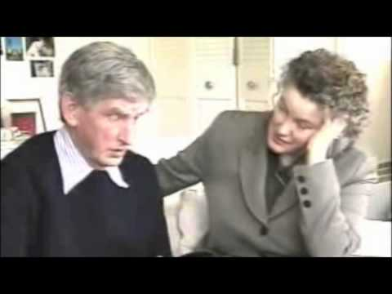
What do you see? What do you think? What do you wonder?
https://youtu.be/c62C_yTUyVg
3.10

Slide 15
Amnesia patients
Amnesia is an impairment of memory. There are several different types.
Milner et al (1968) studied a unique (and, to psychologists, very famous) amnesia patient called ‘HM’.
What does Milner’s case study tell us about the structure and functioning of human memory?

Slide 16
Deep Reading
A study technique for learning more from complex texts.
1. Choose a ‘teacher’
2. Silent reading (one section)
3. Teacher asks a ‘teacher’s question’, rest of group discusses and agrees an answer with teacher.
4. Teacher summarises section.
5. Repeat from step 1 until end of text.

Slide 17
Why read a text this way? How does it compare with what you might do if I just asked you to read the text individually?

Slide 18
Amnesia Patients
Functioning STM but impaired LTM
HM - Milner et al (1968)
Clive Wearing (Dollar, 1986)
Functioning LTM but impaired STM
KF (Shallice & Warrington, 1970)

Slide 19
Describe the studies of memory we learned about last time. Outline their findings.
Explain what the studies show.

Slide 20
“Memory is the residue that thinking leaves behind.” (Willingham, 2009)

