Slide 1
Biological Psychology
1. The central nervous system

Slide 2
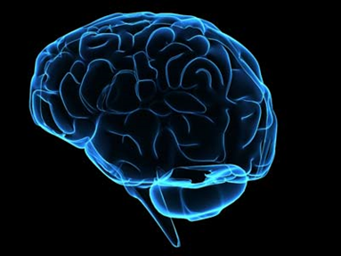
What claim is made? Do you agree?
You are your brain. Your thoughts, feelings, desires, regrets, aspirations, hopes and fears are all a consequence of the structure and functioning of a couple of kilos of pinkish-grey goo, sitting inside your skull. Your brain is you. Anything that influences the structure or functioning of your brain will change something of your thoughts, feelings, desires and so on...you are the changes that take place in your brain, and a change to your brain will change who you are.

Slide 3
What we need to learn...
 | Defining nervous system, central nervous system, localisation & lateralisation of function. Describing locations of key brain areas including prefrontal, motor, somatosensory & visual cortices, Wernicke’s and Broca’s areas. Describing ways of investigating brain function using scans: CAT, PET and fMRI. | Learning habits: Skills:
 | AND classifying behaviours in relation to brain areas; analysing contributions of different brain areas to complex behaviours; comparing different ways of scanning the brain.
 | AND using these effects to predict the results of brain damage in specific areas. Evaluating different sorts of brain scan.

Slide 4
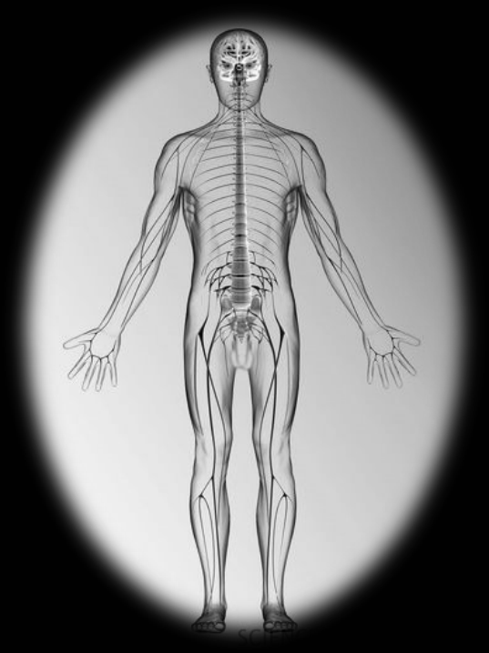
The nervous system
The nervous system is a network of specialised cells capable of transmitting information around the body. It co-ordinates the behaviour of the organism.
The central nervous system processes information. It consists of the brain and spinal cord.

Slide 5
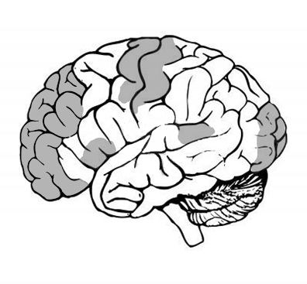
Label the lobes and the shaded areas

Slide 6
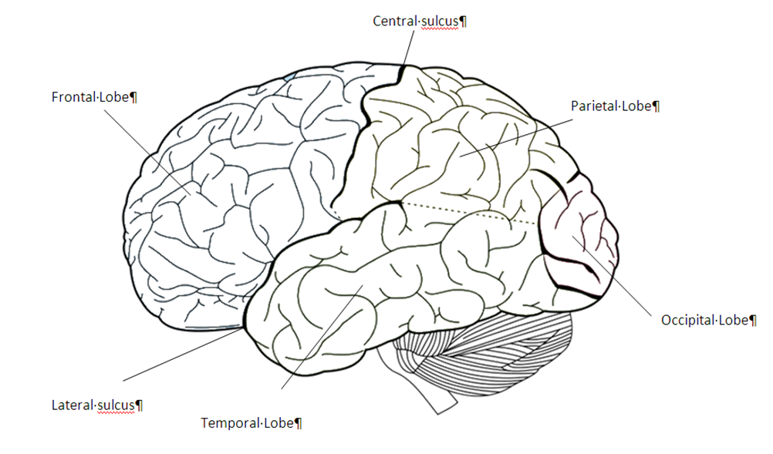
The Brain

Slide 7
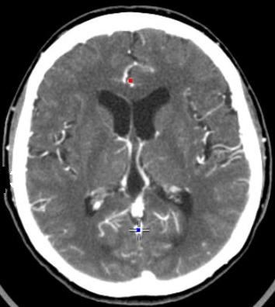
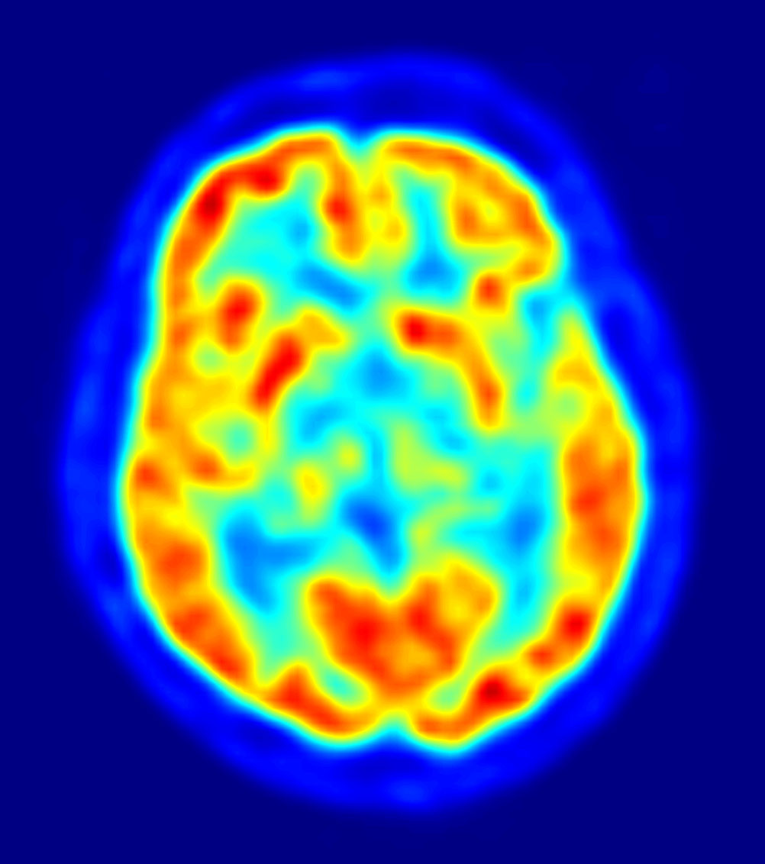
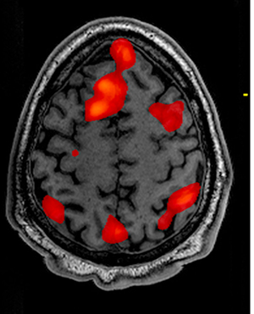
Investigating the brain with scans
CAT/CT Scan
PET Scan
fMRI Scan

Slide 8
CAT/CT, PET or fMRI?
Which technique would you choose to investigate these cases?
What reasons support your choices?
What would be the limitations or drawbacks of your choices?

Slide 9
Comparing
Explaining the similarities and differences between two (or more) things.
1. Identify what the similarity or difference relates to.
2. Give the facts about each to back yourself up.
One difference between ___ and ___ is ___ because one is ___ whereas the other is ___.
One similarity between ___ and ___ is ___ because both ___.
___ is superior to ___ in relation to ___ because ___.

